Slide 1


Slide 2

Sustainability Pledge
Contents
1. Introduction
Pledge Objective
Why We Need To Increase Action
2. Geiger Sustainability Strategy
Sustainability Vision
Sphere of Influence
4 Pillars: Product Design; Packaging; Manufacturing & Operations
3. Sustainability Objectives
Public Commitments
Internal Targets
4. Sustainability Collaborations
Global Commitment
UN Global Compact
UN Sustainable Development Goals (SDGs)
5. Why We Need Your Help?
Vendor Partnerships
Customer Partnerships

Slide 3

Introduction:
Pledge Objective and Why We Need To Increase Action?
Geiger are passionate about sustainability and proud of our achievements to dae but there is more work to do on this critical issue for our planet.
The purpose of this Pledge is to clearly document: our sustainability strategy; objectives; requirements for products & packaging; and expectations for vendor and customer partnerships.
We hope that clarifying our position will help to: motivate and inspire our team; create more meaningful partnerships with vendors and customers; help ensure the achievement of shared goals and objectives.
So why now? Our climate is changing and the natural resources which power and enable our supply chains are in decline. At the same time, landfills are over-flowing with waste and our oceans are littered with plastics.
We are an ambitious and growing company but we want to grow in a responsible way that meets the needs of today without depriving the ability of future generations to do the same. The next 8 years are crucial for the future of our planet if we are to achieve the Sustainable Development Goals outlined by the United Nations and as a leader in our industry and signatory to the UN Global Compact, we need to play our part.

Slide 4

Sustainability Strategy:
Vision
Our vision on sustainability is clear:
To ensure our products and services have the smallest possible environmental footprint and make a positive contribution to the sustainable development of our organisation, people and planet.
To realise our vision, Geiger pledges to:
Carefully select and promote more sustainable products and services;
Engage our internal teams, vendors and customers on sustainability;
Carefully consider the impact of our products and operations on the environment and communities;
Adopt more responsible purchasing practices and operational processes.

Slide 5

Sustainability Strategy:
Sphere of Influence
“it takes more than 4 times as much energy to manufacture a paper bag as it does to manufacture a plastic bag."
Sustainability is a complex problem, with different geographical, cultural, technical and social challenges.
There is not one easy solution to fix everything so we need to consider our own sphere of influence – what are the areas where we can make a genuine difference and help reduce environmental impact.
As a leading supplier of promotional merchandise, we need to look into our supply chain; our operations; the products and packaging we place on the market; the manufacturing methods used to produce them and what happens to them at end of life.
To be truly impactful, we need to consider:
Our use of resources for products and packaging
Chemical & waste management policy
Air pollution & carbon footprint
Safer working environments in the lower tiers of the supply chain
“Ditching single-use plastics by replacing them with biodegradable or compostable versions could cause more problems than it’s fixing if they are not disposed of correctly.”
“Microfibres derived from sustainable and natural fibres such as cotton and linen have now been found in greater abundance than synthetic textile microfibres in the deep seas of southern Europe,”

Slide 6

Sustainability Strategy:
4 Pillars
Our Sustainability strategy covers the following 4 pillars, which consider the full product journey from design and production to delivery and end of life: Product Design; Packaging; Manufacturing and Operations.
Product Design
To ensure our products have the smallest possible environmental footprint, our product design and promotion strategy considers raw material selection; waste avoidance; recyclability and durability of every high value product we supply.
Packaging
Our strategy is to reduce the amount of unnecessary packaging for our products, whilst carefully considering the material for the packaging we do need and working with vendors to make it lighter, smaller and reusable or recyclable where possible.
Manufacturing
Transparency in our supply chain is key to ensure we have visibility of production processes and are able to avoid the most polluting practices. We are also working with vendors to avoid harmful chemicals and Substances of Very High Concern (SVHC); reduce use of resources and ensure waste and emissions are managed.
Operations
Internally, we are recycling 100% of recyclable waste material and samples from our DC; tracking our energy usage and carbon footprint for high value orders; avoiding unnecessary travel and partnering with local service providers to minimize carbon footprint.

Slide 7

Sustainability Strategy:
4 Pillars – Product Design
Giving Back To The Community
We are also actively promoting ‘products that give back’ and purchase of these products helps to help support environmental initiatives and developing communities around the world.
Circular Solutions
Geiger are also working with vendors to develop closed loop solutions for apparel, plastic and textile products for our customers to ensure that products are collected, recycled and sent back into the supply chain for future re-use.
Product Design
As part of our strategy for product, Geiger are actively promoting and designing promotional products with a low environmental impact in every custom brief we work on.
These products are:
Derived from recycled; sustainable or naturally regenerative raw materials
High quality with a high level of durability (no single use or disposable items)
Recyclable at end of life

Slide 8
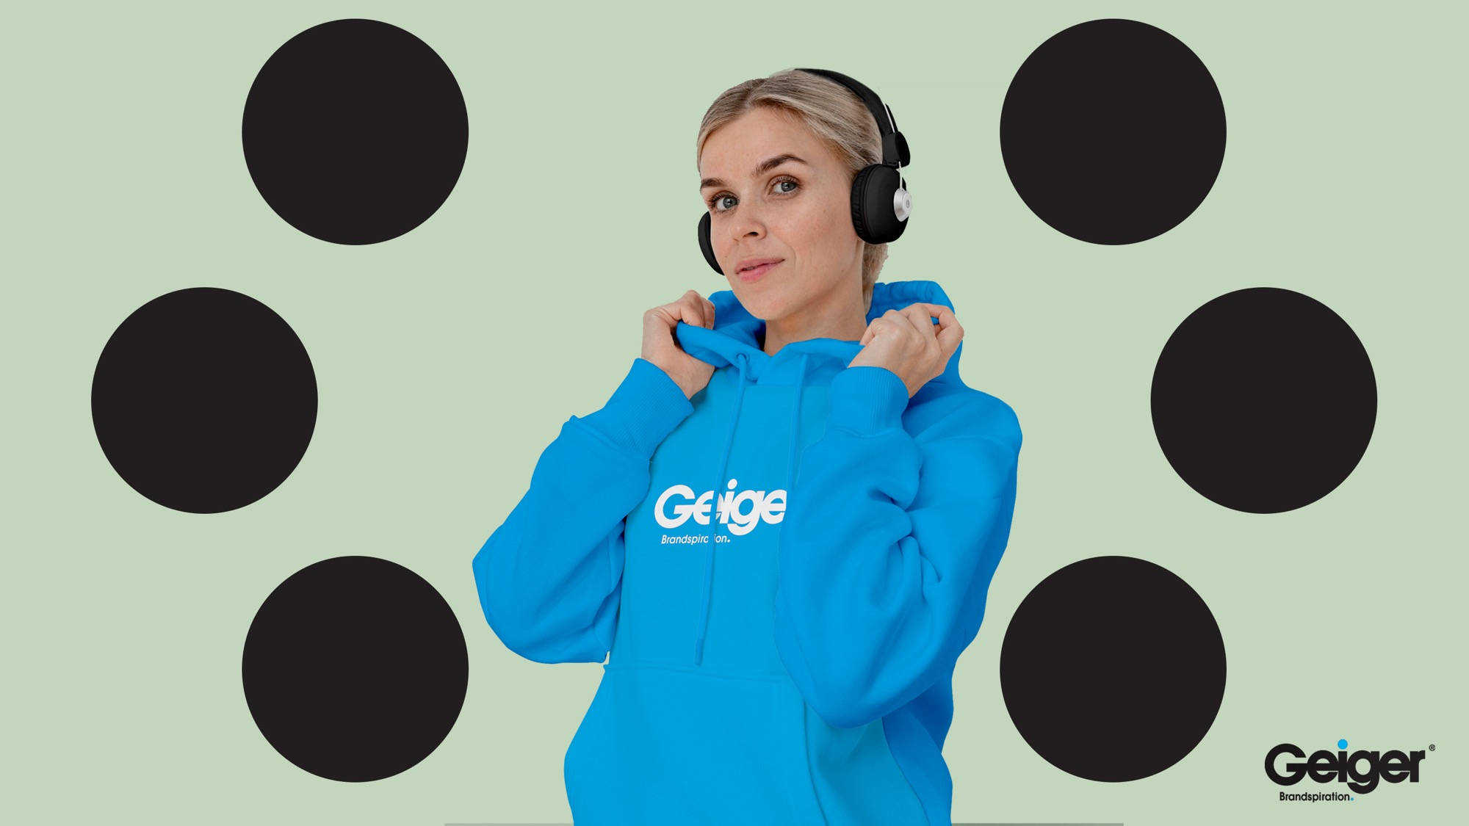
Example of Product Considerations
Origin of the
raw material:
Is it responsibly sourced?
Organic?
Land use or human rights impact?
Durability:
Long Lasting?
Functional - warm,
soft & breathable?
Washable?
Manufacturing Processes:
Water usage?
Chemical management of dyes?
Waste management for off-cuts?
Transport:
Packaging options
Shipping method
Pollution
Carbon footprint
User Phase:
Micro-fibres released into environment?
Washing temp & frequency?
Durability?
End of Life:
Can material be recycled?
Second-hand use?
Widely recycled?
Does labelling offer advice?

Slide 9

Sustainability Strategy:
4 Pillars - Packaging
We are working with vendors and service providers to minimize negative environmental impact from the packaging we need to protect and deliver our products safely to customers.
We are committed to:
Limiting unnecessary use of plastic packaging
Including recycled content in all of our essential plastic packaging
Only putting recyclable or reusable or biodegradable plastic packaging on the market
Replace bubble wrap for delicate items with recycled shredded paper
Making sure that additional components and finishes don’t impact the recyclability of the packaging
Using Forest Stewardship Council (FSC) certified paper and card from our vendors.
For plastics, we are committed to avoiding non-recyclable and worst polluting materials where possible including PETG (polyethylene terephthalate-glycol); PVC (polyvinyl chloride) and PS (polystyrene).
To safeguard our commitment, we are implementing a checklist for our internal teams and vendors to make sure that:
All the elements of the required packaging have a function þ
The packaging is recyclable þ
The packaging includes recycled, recyclable, biodegradable material þ

Slide 10
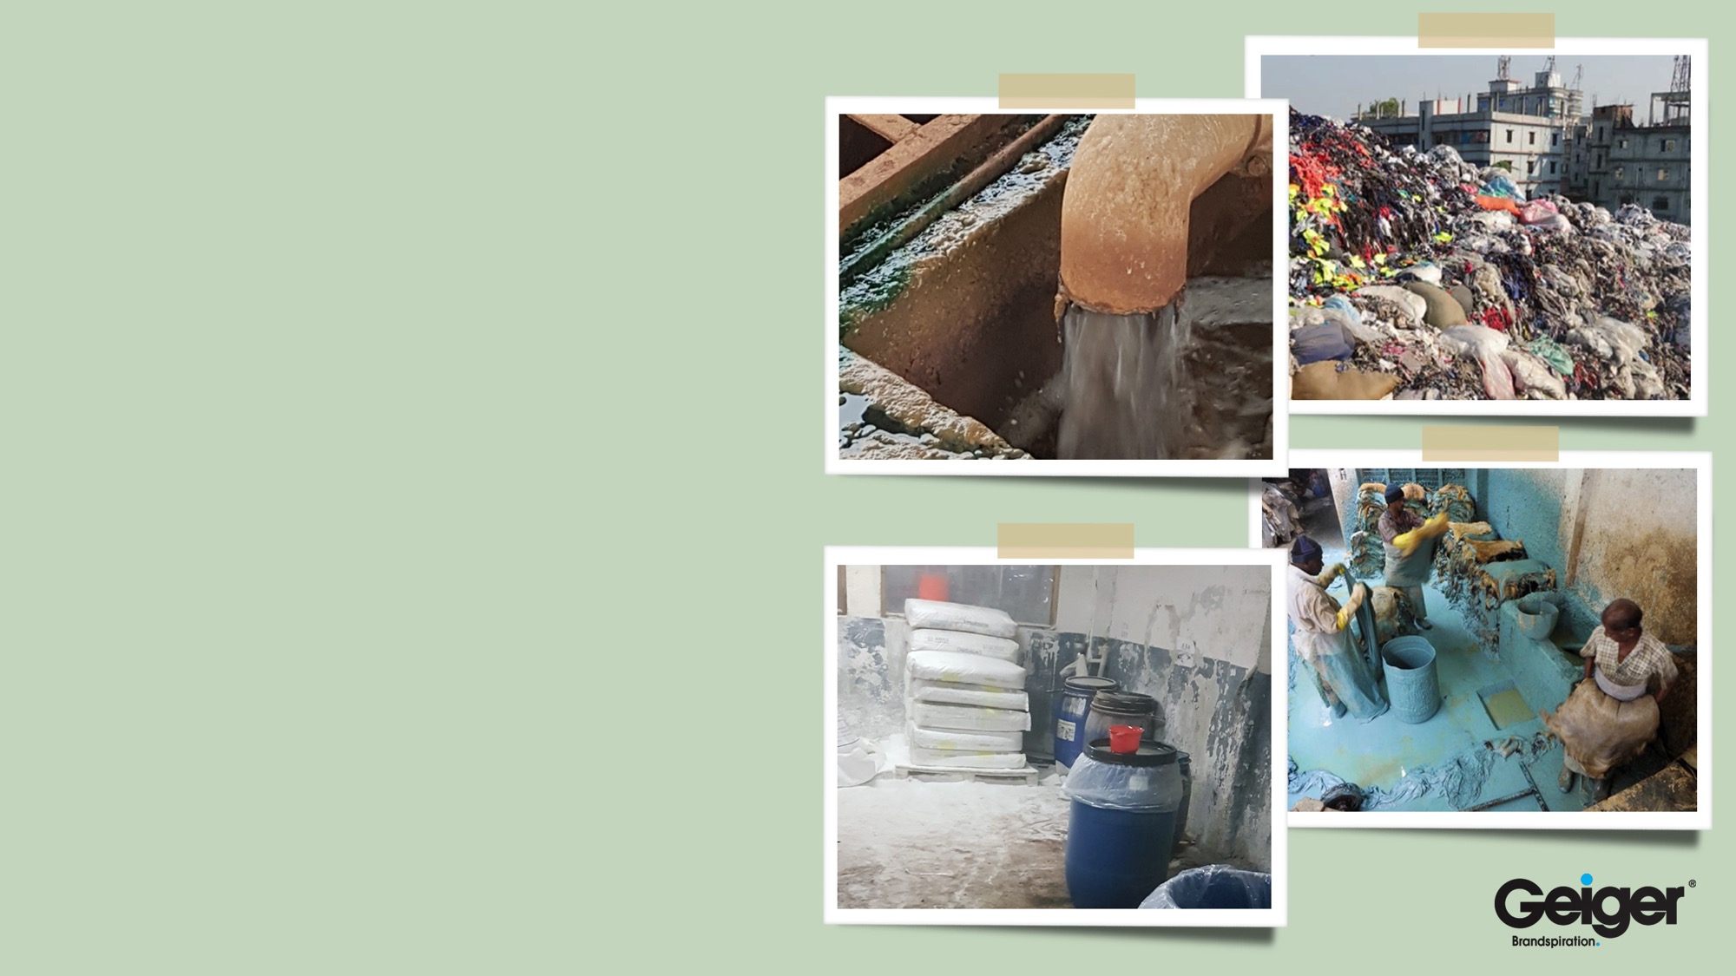
Sustainability Strategy:
4 Pillars - Manufacturing
Geiger is committed to avoiding the most polluting and resource heavy production methods in our supply chain to help reduce our footprint, lower the risk level for factory workers and help us be better stewards of our environment.
Areas to focus on include:
Greater transparency in our supply chain to know the source of raw materials and location of production.
Avoidance of hazardous Azo Dyes and SVHCs.
Reduction of water usage through use of natural colours and organic materials.
Avoidance of toxic processes such as electro plating and unnecessary production of carbon black.
Promotion of locally manufactured products.
Using water based and natural inks for printing.
Careful production planning to increase efficiency, reduce waste and minimize pollution.

Slide 11

Sustainability Strategy:
4 Pillars - Operations
In our internal Geiger operations, we are working to:
Recycle or reuse 100% of unwanted samples.
Monitor and track our energy and water usage to achieve a 10% year on year reduction.
Install energy efficient lighting in our warehouse and office space.
Ensure computer equipment and power supplies are turned off when not in use.
Minimize use of chemicals for cleaning and production.
Minimize noise and air pollution to the local environment from machinery and deliveries.
Recording and reporting on weight of primary and secondary packaging for key customers.
From Q1 2022, we are starting to track carbon footprint of all high value orders above £20k.

Slide 12
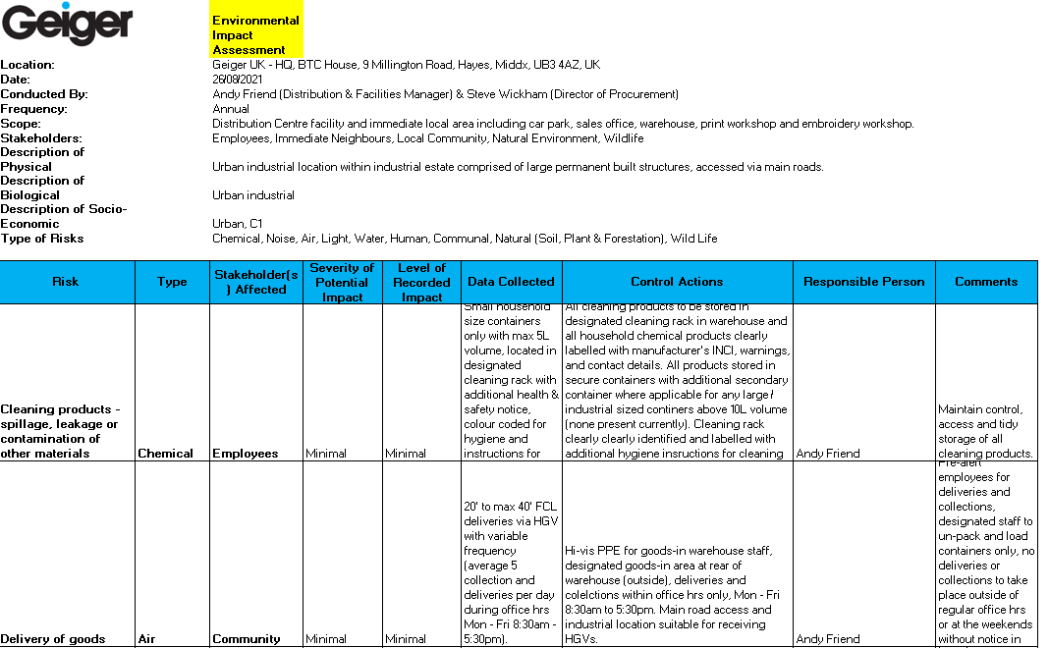
Sustainability Objectives:
KPIs
In 2021 we started tracking the following Key Performance Indicators (KPIs) on Sustainability:
Recording all products sold with sustainable features in our order management system.
% of quotes proposed to customers including sustainable options.
Energy, gas and water usage reduction in our UK Distribution Centre.
Weight of primary and secondary packaging material for key customers.
We also completed our first Environmental Impact Assessment which highlighted our potential Chemical, Noise, Air, Light, Water, Human, Communal, Natural & Wild-Life risks along with the impacted stakeholders and severity of impact for each hazard.
In 2022 we will introduce additional KPIs to closer monitor and improve environmental performance:
Carbon footprint of all high value orders above £20k.
Primary & Secondary Packaging Weights for all high value orders above £20k.
Weight of all recycled plastic products supplied.
Weight of all fresh plastic avoided through use of recycled alternatives.

Slide 13

Sustainability Strategy:
Public Commitments
By 2025 we pledge to strive to achieve the following targets:
Minimum 75% of paper and cardboard packaging to be FSC certified or recycled.
100% of plastic packaging to be reusable, recyclable or compostable.
Eliminate 100% of problematic and unnecessary plastics that can not be reused or recycled.
Achieving 10% year on year water and energy usage reduction for our UK and US Decoration and Distribution Centres.
Tracking carbon footprint of high value orders above £20k from Q1 2022 with the objective of achieving 30% reduction in carbon footprint by 2025 and carbon neutrality by 2030 through careful selection of materials, transport and production partners and utilisation of off-set schemes.
Adoption of responsible sourcing rules for highest priority raw materials and communication of a restricted materials and substances list to vendors.
Adoption of new approach to single use products ensuring that durable alternatives are always available.
Contributing to reduction of waste, water and energy usage across our supply chain through education, leadership and strategic partnership with preferred vendors.

Slide 14

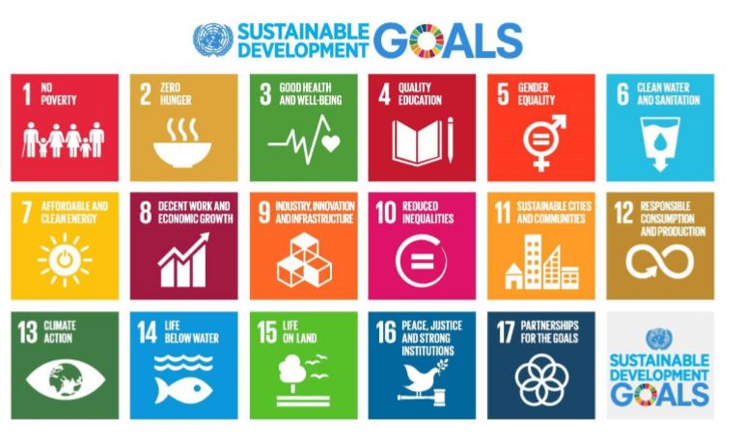
Sustainability Collaborations:
UN Global Compact & SDGs
Geiger is a proud signatory of the United Nations (UN) Global Compact, along with over 9,000 other purpose driven companies in over 160 countries worldwide, in support of 10 UN goals including:
Commitments to support a precautionary and responsible approach to environmental challenges;
Undertaking initiatives to promote greater environmental responsibility;
Encourage the development and use of environmentally friendly materials and technologies.
By focusing our efforts, we aim to make a positive contribution towards the achievement of the UN Sustainable Development Goals (SDGs) which provide an essential blueprint for achieving a better and more sustainable future for all by 2030.
The 17 SDGs address the global challenges we all face, including those related to poverty, inequality, climate change, environmental degradation, peace and justice.

Slide 15



Sustainability Collaborations:
UN SDGs
So how can Geiger support the UN SDGs?
SDG 1:
No Poverty
We can support SDG 1 through forming long term partnerships with vendors and supporting the continued development of workers lives and their communities in the poorer areas of low cost sourcing countries.
SDG 4:
Quality Education
We can support SDG 4 by providing training to our internal teams, customers and vendors on responsible buying practices, responsible consumption, sustainable production methods and sustainable products and materials.

Slide 16


Sustainability Collaborations:
UN SDGs
SDG 8:
Decent Work
We can support SDG 8 by creating jobs and encouraging vendors to improve working conditions in the supply chain to ensure workers feel safe and respected; have a voice and earn more than the local minimum wage for the work they do.
By educating vendors on working hours limits and avoiding the worst polluting production processes, we reduce the pressure for excessive overtime, help ensure workers and their communities are safe and have a positive work-life balance.
We can directly reward vendors with increased and sustained business levels in return for demonstrating improved social and environmental performance in audits.

Slide 17



Sustainability Collaborations:
UN SDGs
SDG 5:
Gender Equality
We can support SDG 5 through promoting our internal equality, diversion and inclusion policy and participating in initiatives and research designed to increase gender equality in the supply chain. We can also reward vendors who demonstrate a positive gender balance on pay, position and practices with increasing business levels.
SDG 9:
Industry Innovation
and Infrastructure
We can support SDG 9 by identifying, promoting and enabling innovation in raw materials, products and production methods.

Slide 18



Sustainability Collaborations:
UN SDGs
SDG 13:
Climate Action
We can support SDG 13 by educating vendors on clean production processes and helping customers make informed and responsible choices. We can also support progress by ensuring that our products and packaging are from resources that are renewable and regenerative taking into account the product lifecycle, manufacturing process and materials used.
SDG 12:
Responsible Consumption
and Production
We can support SDG 12 by reducing waste and unnecessary packaging and by promoting sustainable consumption with vendors and customers and using recycled, recyclable and regenerative materials, clearly labelled with end of life in mind.

Slide 19

Vendor Partnerships:
Why we need your help?
We need like minded vendors to partner with us to help make the biggest possible difference.
Vendors aligned with our values will benefit from increasing order levels so we are actively looking for strategic production partners who can:
Commit to complying with our ethical Code Of Conduct.
Provide safe, respectful and meaningful jobs for workers.
Bring new ideas to the table for reducing energy consumption and waste.
Innovate with sustainable materials and cleaner production methods.
Cooperate on new sustainable product development.
Share data on impact of production and delivery.
We need vendors to be pro-active and get involved on this topic! By working together, we can measure combined impact on the planet of products, services and raw materials throughout the supply chain.
We encourage vendors to develop their own sustainability programs and convey our Code Of Conduct expectations to their own material suppliers and subcontractors, and monitor their own performance on environmental KPIs.
Honesty and transparency is also vital so we can understand true social and environmental impact and make genuine improvements to help grow our businesses together for a more sustainable future.

Slide 20

Customer Partnerships:
Let’s work together for maximum positive impact!
We know our customers are already taking sustainability seriously.
Many have made public commitments to reduce waste, energy usage and carbon footprint.
We can help customers achieve their sustainability goals and demonstrate progress against public commitments by:
Always proposing sustainable alternatives.
Sharing sustainability data.
Encouraging responsible procurement from local and ethical sources.
Educating and informing on the latest innovations in materials, production methods and end of life recycling solutions.
We encourage customers to be bold with product selection; be responsible with requirements for tenders and briefs; consider the environmental impact of the products given to their own employees and consumers who are increasingly passionate on sustainability.
We are aligned on values, we have the same goals and objectives so let’s work together in partnership to ensure our products and services have the smallest possible environmental footprint and make a positive contribution to the sustainable development of our organisation, people and planet.

Slide 21


Let’s work together to ensure a sustainable future for all.
Thank You!

